Slide 1
Machine Learning Decision Tree (ch 6)
Dr. Malak Abdullah
Computer Science Department
Jordan University of Science and Technology

Slide 2
Decision Tree
Decision Tree : Decision tree is the most powerful and popular tool for classification and prediction. A Decision tree is a flowchart like tree structure, where each internal node denotes a test on an attribute, each branch represents an outcome of the test, and each leaf node (terminal node) holds a class label.
Decision tree is a type of supervised learning algorithm (having a pre-defined target variable) that is mostly used in classification problems. It works for both categorical and continuous input and output variables. In this technique, we split the population or sample into two or more homogeneous sets (or sub-populations) based on most significant splitter / differentiator in input variables.
The decision tree algorithm tries to solve the problem, by using tree representation. Each internal node of the tree corresponds to an attribute, and each leaf node corresponds to a class label.
The main drawback of Decision Tree is that it generally leads to overfitting of the data

Slide 3
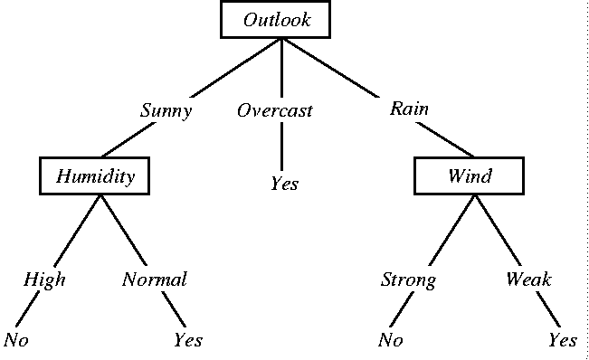
A Simple Decision Tree

Slide 4
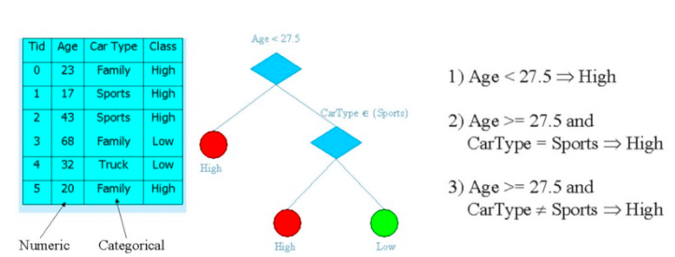
Decision tree
A decision tree is a tree where each node represents a feature (attribute), each link (branch) represents a decision(rule) and each leaf represents an outcome (categorical or continues value).

Slide 5
Representation
internal node = attribute test
branch = attribute value
leaf node = classification

Slide 6
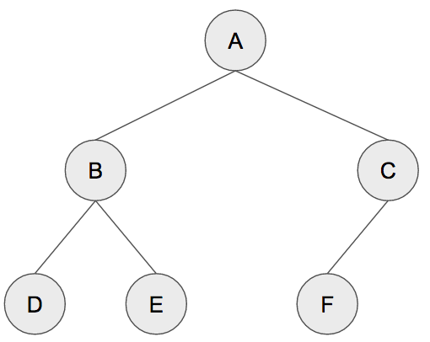
The tree
Terminology
Root = A
Depth =2
Leaf = D E F
a binary tree, each parent node must have at most 2 child nodes

Slide 7
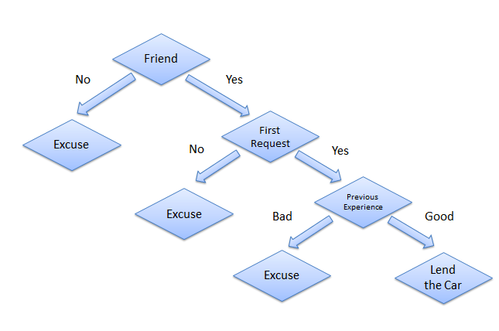
Example from the life
Consider a scenario where a person asks you to lend them your car for a day, and you have to make a decision whether or not to lend them the car. There are several factors that help determine your decision, some of which have been listed below:
Is this person a close friend or you just slightly know him? If he is not a close friend, then decline the request; if the person is a friend, then move to next step.
Is the person asking for the car for the first time? If so, lend them the car, otherwise move to next step.
Was the car damaged last time they returned the car? If yes, decline the request; if no, lend them the car.

Slide 8
Assumptions while creating Decision Tree
At the beginning, the whole training set is considered as the root.
Feature values are preferred to be categorical. If the values are continuous then they are discretized prior to building the model.
Records are distributed recursively on the basis of attribute values.
Order to placing attributes as root or internal node of the tree is done by using some statistical approach.

Slide 9
Splitting
Trying to find and return the smallest possible decision tree that accurately classifies the training set is very very hard. In fact, it’s an NP-hard problem.
Instead, we’ll try to approximate the best result instead of getting the best result. We’re going to talk a lot about probability and statistics.
What we want is information that explicitly splits the data into two. We don’t want something that can include both A and B classes, we want purity. One singular class for each split.
The measure of purity is called information. It represents the expected amount of information that would be needed to specify whether a new instance should be classified as the left or right split.
Entropy is a measure of impurity. It’s how uncertain something is.

Slide 10
Decision Tree
Very simple yet powerful supervised learning methods
Utilizes an if-then rule set
The rules are learned sequentially using the training data one at a time
For each attribute in the dataset, the algorithm forms a node, where the most important attribute is placed at the root node
Each time a rule is learned, the tuples covered by the rules are removed
This process is continued on the training set until meeting a termination condition
A decision tree can be easily over-fitted generating too many branches and may reflect anomalies due to noise or outliers
This can be avoided by pre-pruning which halts tree construction early or post-pruning which removes branches from the fully grown tree

Slide 11
DT algorithms
Decision trees use multiple algorithms to decide to split a node in two or more sub-nodes. The creation of sub-nodes increases the homogeneity of resultant sub-nodes. In other words, we can say that purity of the node increases with respect to the target variable. Decision tree splits the nodes on all available variables and then selects the split which results in most homogeneous sub-nodes.
The algorithm selection is also based on type of target variables. The four most commonly used algorithms in decision tree are:
Gini Index
Information Gain
Chi-square
Reduction in Variance

Slide 12
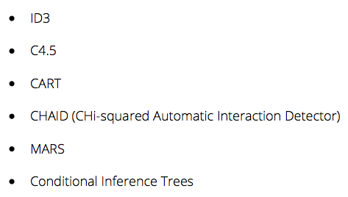
Decision Trees

Slide 13
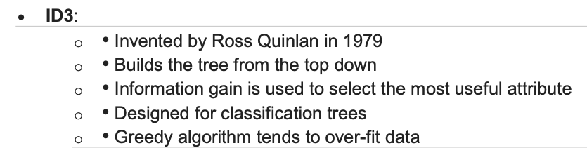
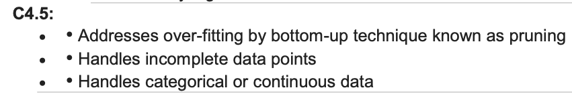
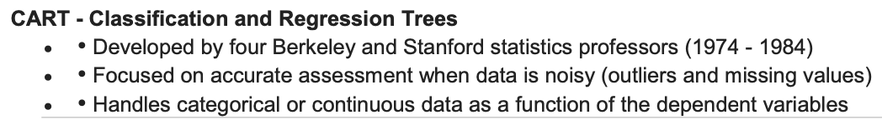

Slide 14
Gini Index
Gini index or Gini impurity measures the degree or probability of a particular variable being wrongly classified when it is randomly chosen. But what is actually meant by ‘impurity’? If all the elements belong to a single class, then it can be called pure. The degree of Gini index varies between 0 and 1, where 0 denotes that all elements belong to a certain class or if there exists only one class, and 1 denotes that the elements are randomly distributed across various classes. A Gini Index of 0.5 denotes equally distributed elements into some classes.
It works with categorical target variable “Success” or “Failure”.
It performs only Binary splits
CART (Classification and Regression Tree) uses Gini method to create binary splits.

Slide 15
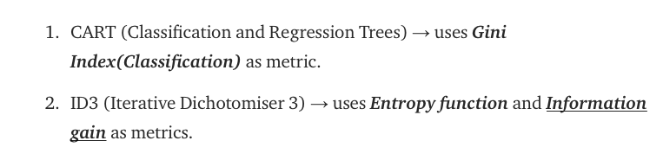
CART & ID3
Scikit-Learn uses the CART algorithm, which produces only binary trees: non leaf nodes always have two children (i.e., questions only have yes/no answers).
Other algorithms such as ID3 can produce Decision Trees with nodes that have more than two children

Slide 16
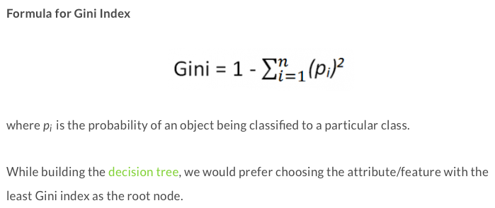
Steps to Calculate Gini for a split
Calculate Gini for split using weighted Gini score of each node of that split

Slide 17
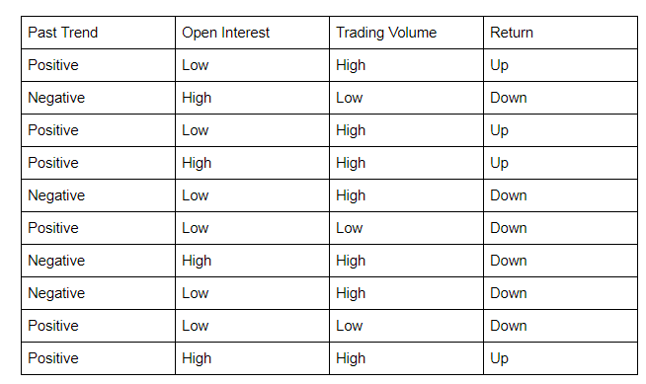
Example of Gini index Decision tree
Let’s start by calculating the Gini Index for ‘Past Trend’.
P(Past Trend=Positive): 6/10
P(Past Trend=Negative): 4/10
If (Past Trend = Positive & Return = Up), probability = 4/6
If (Past Trend = Positive & Return = Down), probability = 2/6
Gini index = 1 - ((4/6)^2 + (2/6)^2) = 0.45
If (Past Trend = Negative & Return = Up), probability = 0
If (Past Trend = Negative & Return = Down), probability = 4/4
Gini index = 1 - ((0)^2 + (4/4)^2) = 0
Weighted sum of the Gini Indices can be calculated as follows:
Gini Index for Past Trend = (6/10)0.45 + (4/10)0 = 0.27

Slide 18
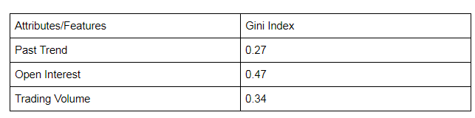
Continue of Example
Gini Index for Past Trend = (6/10)0.45 + (4/10)0 = 0.27
Gini Index for Open Interest = (4/10)0.5 + (6/10)0.45 = 0.47
Gini Index for Trading Volume = (7/10)0.49 + (3/10)0 = 0.34
We observe that ‘Past Trend’ has the lowest Gini Index and hence it will be chosen as the root node
We will repeat the same procedure to determine the sub-nodes or branches of the DT.

Slide 19
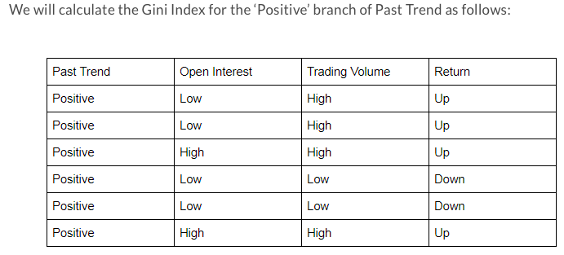
Continue of Example
If (Open Interest = High & Return = Up), probability = 2/2
If (Open Interest = High & Return = Down), probability = 0
Gini index = 1 - (sq(2/2) + sq(0)) = 0
If we do the same for the Open Interest=Low then the Gini =0.5
Continue → the weighted average of gini→
Gini Index for Open Interest = (2/6)0 + (4/6)0.50 = 0.33
Gini Index for Trading Volume = (4/6)0 + (2/6)0 = 0
We will split the node further using the ‘Trading Volume’ feature, as it has the minimum Gini index.
https://blog.quantinsti.com/gini-index/

Slide 20
Lets watch the following video
https://www.youtube.com/watch?v=7VeUPuFGJHk&feature=youtu.be&t=210

Slide 21
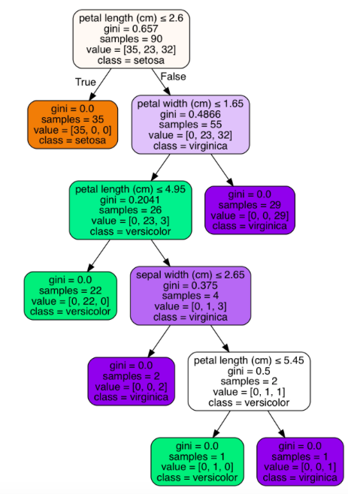
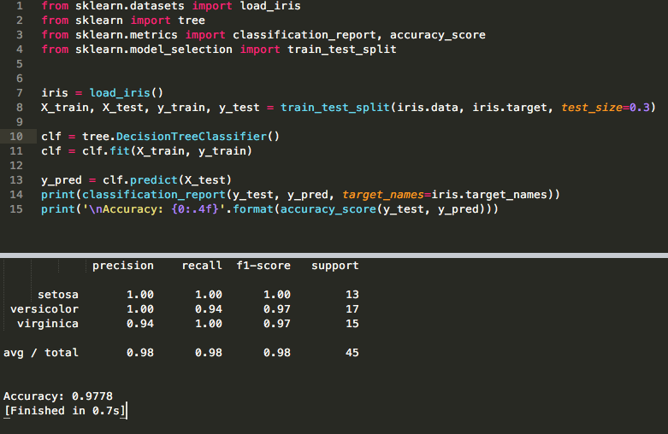
Sklearn decision tree

Slide 22
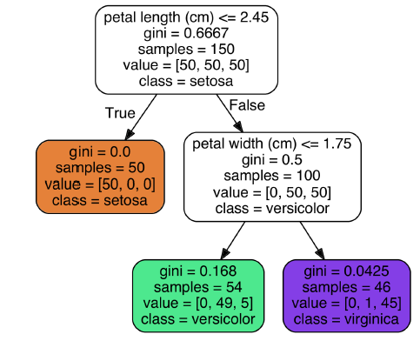

Nodes
Gini: measures the impurity of a node
(gini=0) if all training instances it applies to belong to the same class
Gini= 0.168 = 1- (0/54)^2 +(49/54)^2+(5/54)^2
The Gini equation →
Samples: counts how many training instances it applies to.
Value: tells you how many training instances of each class this node applies to
The probability of a flower whose petals are 5 cm long and 1.5 cm wide
0% for Iris-Setosa (0/54), 90.7% for Iris-Versicolor (49/54), and 9.3% for Iris-Virginica (5/54) = Iris-Versicolor (class 1)

Slide 23
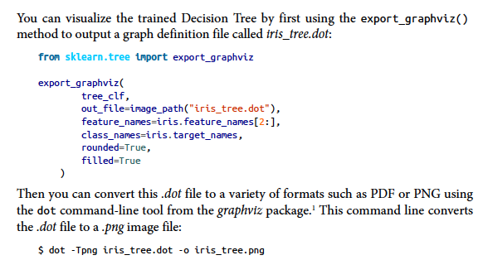
Visualize the tree

Slide 24
the CART (Classification and Regression Trees)
A decision tree is a binary tree, so we need to make sure that there are no more than two splits per node.
We want to make splits so that we have many examples of only one particular class and few examples of the other.
In other words, we want the split that decreases the entropy. High entropy means that we have a mix of different classes; low entropy means that we have (to a great degree) one class.
Ideally, we want our nodes to have no entropy, i.e., all examples at this node are definitely of one class.
Gini impurity and entropy mean the same thing: we want lower Gini impurity.
Gini Impurity or Entropy? By default it is Gini (scikit learn)
The truth is, most of the time it does not make a big difference: they lead to similar trees. Gini impurity is slightly faster to compute, so it is a good default.
Entropy tends to produce slightly more balanced trees.
clf = DecisionTreeClassifier(criterion = "gini", random_state = 100, max_depth=3, min_samples_leaf=5)

Slide 25


Gini and Entropy
Gini: measures the impurity of a node
(gini=0) if all training instances it applies to belong to the same class
Gini= 0.168 = 1- (49/54)^2+(5/54)^2
The Gini equation →
Entropy: it is frequently used as an impurity measure: a set’s entropy is zero when it contains instances of only one class.
Entropy equation →

Slide 26
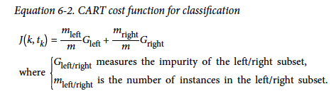
the CART (Classification and Regression Trees)
Continuous data : https://youtu.be/7VeUPuFGJHk?t=842
First splits the training set in two subsets using a single feature k and a threshold tk (e.g., “petal length ≤ 2.45 cm”).
How does it choose k and tk?
It searches for the pair (k, tk) that produces the purest subsets (weighted by their size).
It stops recursing once it reaches the maximum depth (defined by the max_depth hyperparameter), or if it cannot find a split that will reduce impurity.

Slide 27
CART is Greedy
As you can see, the CART algorithm is a greedy algorithm: it greedily searches for an optimum split at the top level, then repeats the process at each level.
It does not check whether or not the split will lead to the lowest possible impurity several levels down.
A greedy algorithm often produces a reasonably good solution, but it is not guaranteed to be the optimal solution.
Unfortunately, finding the optimal tree is known to be an NP-Complete problem
We can prune nodes, starting from the leaves. We compute the increase in entropy/impurity at the parent if we were to prune two child nodes, and perform the pruning if that entropy/impurity increase is below some constant or threshold.

Slide 28
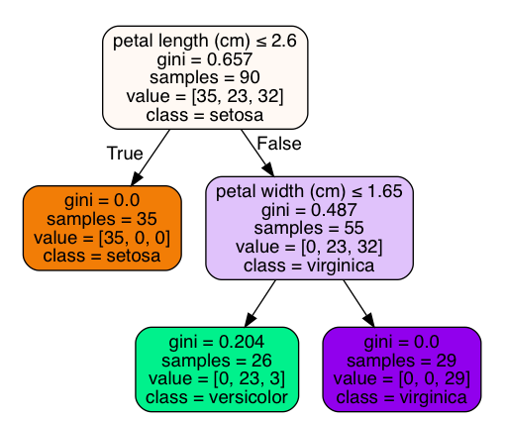
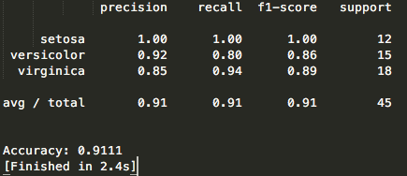
Prune
Let’s mess with the minimum entropy threshold parameter to see if we can prune this tree and how that affects the accuracy.
Let’s set it to 0.1. A node will be split if this split makes a decrease of the impurity greater than or equal to this value.
clf = tree.DecisionTreeClassifier(min_impurity_decrease=0.1)

Slide 29
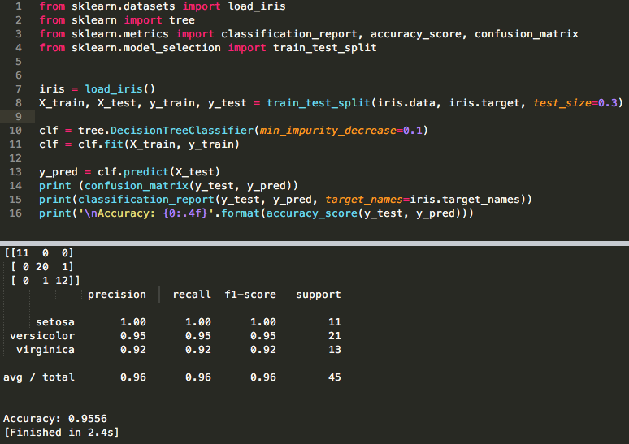
print (confusion_matrix(y_test, y_pred))

Slide 30
Tune the parameters
max_depth: int or None, optional (default=None)
The maximum depth of the tree. If None, then nodes are expanded until all leaves are pure or until all leaves contain less than min_samples_split samples.
min_samples_split: int, float, optional (default=2)
The minimum number of samples required to split an internal node
min_samples_leaf: int, float, optional (default=1)
The minimum number of samples required to be at a leaf node. A split point at any depth will only be considered if it leaves at least min_samples_leaf training samples in each of the left and right branches. This may have the effect of smoothing the model, especially in regression.
And others ☺

Slide 31
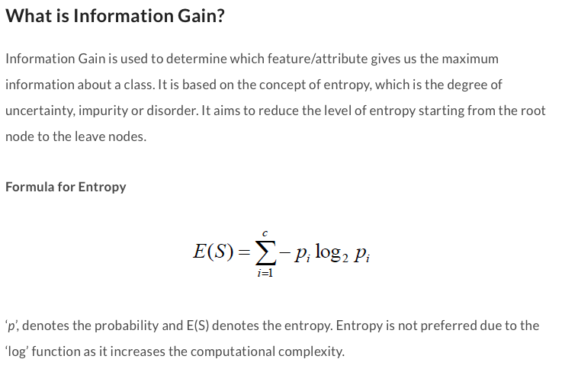
ID3
ID3 uses Entropy and Information Gain to construct a decision tree.
https://medium.com/@rishabhjain_22692/decision-trees-it-begins-here-93ff54ef134

Slide 32

Information Gain
A statistical property called information gain, measures how well a given attribute separates the training examples
Information gain uses the notion of entropy, commonly used in information theory
Information gain = expected reduction of entropy
Values(A) is the set of all possible values for attribute A, and Sv the subset of S for which attribute A has value v Sv = {s in S | A(s) = v}.
the first term in the equation for Gain is just the entropy of the original collection S
the second term is the expected value of the entropy after S is partitioned using attribute A

Slide 33
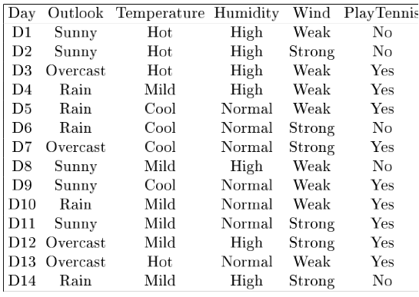
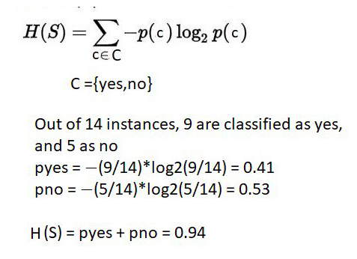
Example
Notes:
Target attrbute = playtennis

Slide 34
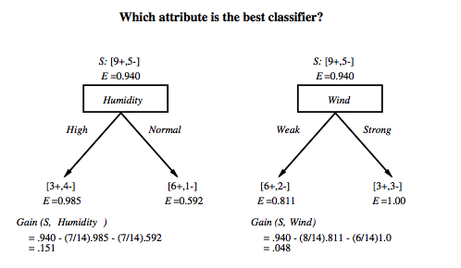
Which attribute is the best classifier?
High and Yes = 3
High and No = 4

Slide 35
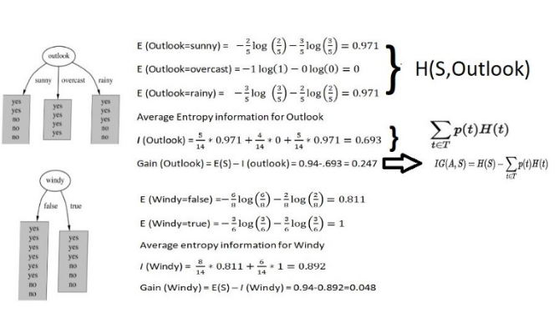
H(S, Wind).
Gain (S, Wind)

Slide 36
First step: which attribute to test at the root?
Which attribute should be tested at the root?
Gain(S, Outlook) = 0.247
Gain(S, Humidity) = 0.151
Gain(S, Wind) = 0.084
Gain(S, Temperature) = 0.029
The highest the better ☺
Outlook provides the best prediction for the target
Lets grow the tree:
add to the tree a successor for each possible value of Outlook
partition the training samples according to the value of Outlook

Slide 37
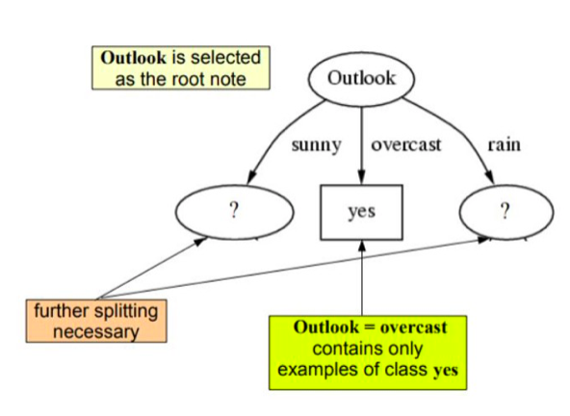
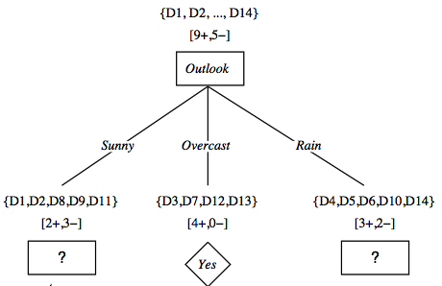
After first step
Entropy is 0.97
See the previous two slides

Slide 38
Second step
Working on Outlook=Sunny node:
Gain(S_{Sunny}, Humidity) = 0.970 − 3/5 × 0.0 − 2/5 × 0.0 = 0.970
Gain(S_{Sunny}, Wind) = 0.970 − 2/5 × 1.0 − 3.5 × 0.918 = 0 .019
Gain(S_{Sunny}, Temp.) = 0.970 − 2/5 × 0.0 − 2/5 × 1.0 − 1/5 × 0.0 = 0.570
Humidity provides the best prediction for the target
Lets grow the tree:
add to the tree a successor for each possible value of Humidity
partition the training samples according to the value of Humidity

Slide 39
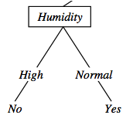
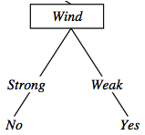
Second and third steps
{D1, D2, D8}
No
{D9, D11}
Yes
{D4, D5, D10}
Yes
{D6, D14}
No

Slide 40
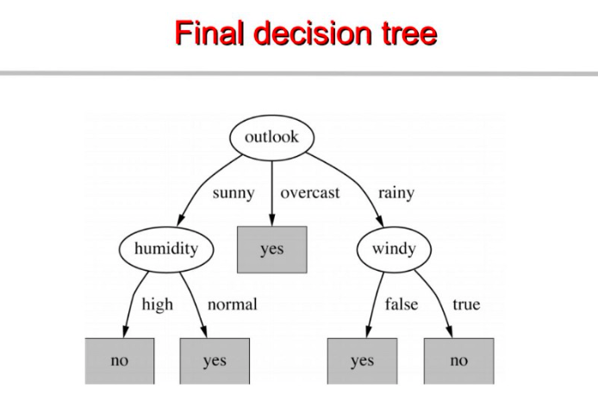

Slide 41
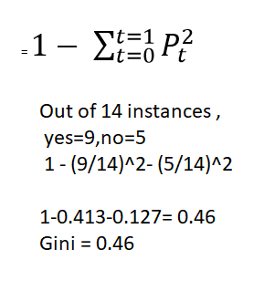
CART for the same example

Slide 42
Predicting Commute Time
Leave At
If we leave at 10 AM and there are no cars stalled on the road, what will our commute time be?
10 AM
9 AM
8 AM
Stall?
Accident?
No
Yes
Long
No
Yes
Short
Long
Medium
Long

Slide 43
Sample Experience Table
Example | Attributes |  |  |  | Target
 | Hour | Weather | Accident | Stall | Commute
D1 | 8 AM | Sunny | No | No | Long
D2 | 8 AM | Cloudy | No | Yes | Long
D3 | 10 AM | Sunny | No | No | Short
D4 | 9 AM | Rainy | Yes | No | Long
D5 | 9 AM | Sunny | Yes | Yes | Long
D6 | 10 AM | Sunny | No | No | Short
D7 | 10 AM | Cloudy | No | No | Short
D8 | 9 AM | Rainy | No | No | Medium
D9 | 9 AM | Sunny | Yes | No | Long
D10 | 10 AM | Cloudy | Yes | Yes | Long
D11 | 10 AM | Rainy | No | No | Short
D12 | 8 AM | Cloudy | Yes | No | Long
D13 | 9 AM | Sunny | No | No | Medium

Slide 44
ID3
Given our commute time sample set, we can calculate the entropy of each attribute at the root node
Attribute | Expected Entropy | Information Gain
Hour | 0.6511 | 0.768449
Weather | 1.28884 | 0.130719
Accident | 0.92307 | 0.496479
Stall | 1.17071 | 0.248842

Slide 45
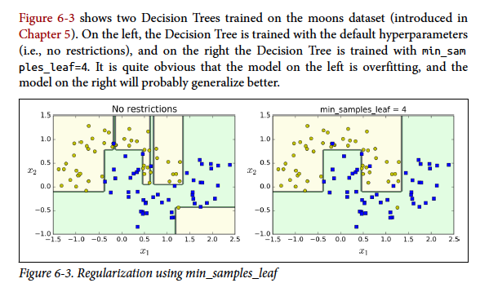
Pruning Trees
A technique for reducing the number of attributes used in a tree - pruning
There are two approaches to prune a tree −
Pre-pruning − The tree is pruned by halting its construction early.
Post-pruning - This approach removes a sub-tree from a fully grown tree.

Slide 46
Prepruning
In prepruning, we decide during the building process when to stop adding attributes (possibly based on their information gain)
However, this may be problematic – Why?
Sometimes attributes individually do not contribute much to a decision, but combined, they may have a significant impact

Slide 47
Postpruning
PostPruning waits until the full decision tree has built and then prunes the attributes
Two techniques:
Subtree Replacement
Subtree Raising

Slide 48
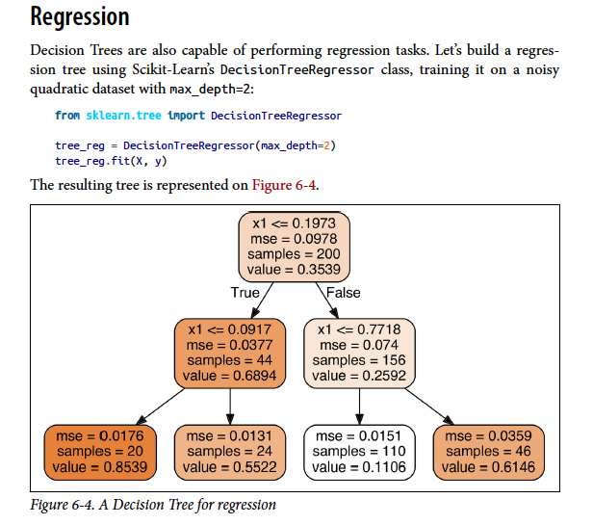
For you
https://www.youtube.com/watch?v=g9c66TUylZ4

Slide 49
Advantages vs Disadvantages
Advantages:
Compared to other algorithms decision trees requires less effort for data preparation during pre-processing.
A decision tree does not require normalization of data.
A decision tree does not require scaling of data as well.
Missing values in the data also do NOT affect the process of building a decision tree to any considerable extent.
A Decision tree model is very intuitive and easy to explain to technical teams as well as stakeholders.
Disadvantage:
A small change in the data can cause a large change in the structure of the decision tree causing instability.
For a Decision tree sometimes calculation can go far more complex compared to other algorithms.
Decision tree often involves higher time to train the model.
Decision tree training is relatively expensive as the complexity and time have taken are more.
The Decision Tree algorithm is not very good for applying regression and predicting continuous values.

